Slide 1
Lazar Lichenovski
modern Macedonian artist

Slide 2
Lichenoski – one of the founders of modern Macedonian art
Lazar Lichenoski belongs to the first group of modern Macedonian artists.
Lichenoski is considered to be one of the founders of the art life in Macedonia.
He is one of the most authentic painters of the Macedonian landscape (“Sheepfold”, “Cupboard”, “Fields of Poppy”, “Ohrid fisherman”).

Slide 3
Biography - Childhood
He was born on 26th March, 1901 (1901-1964).
As a child he lived in Prizren and in Tetovo.
Lazar Lichenovski hailed from a respectable family of builders.
He enrolled high school in Skopje, continued in Tetovo, but he did not finish it because he started working in his father’s carpenter company.
He started earning money by writing the letters of the companies in the bazaar.

Slide 4
Biography - The youth
He finished an art school with academic course in Belgrade, in 1927.
He specialized wall techniques in Paris, in the studio of Marcel Lenoir and at the High school of Applied Arts and Crafts under Paul Baudouin,
he visited the atelier of Andre Lhote and the “Grand Shaumie” Academy.

Slide 5
Creation of Lazar Lichenovski
During his years of studying, until leaving for Paris, Lichenoski created works according to the academic and classical Postulates, which directed to the actual domination of the form at that time: A Street in Belgrade, Tetovsko.
At this period, he created a certain number of drawings and studies: Male’s nude, Female’s nude, a Study of a sculpture in the tomb of Medici.
In his first atelier in Belgrade, Lazar Lichenoski painted a large number of portraits ranging from the daughters of the doctor Danica and Milica and the portraits of Nikolikh, entitled as Portraits of unknown women.

Slide 6
Creation of Lazar Lichenovski
In 1927, on his first independent exhibition in Skopje, he exhibited works which clearly indicated the influence of the popular neoclassicism at that time and the old masters. The next exhibition in Skopje in 1929 and especially the one in Belgrade, the same year, showed a rapid step towards the colorist explication.
On the way across Western Macedonia, from 1929 till 1931 and even later, he created his entire artistic repertoire: landscape, still nature, outside belly dancing, fishermen, portraits, paying attention to houses.

Slide 7
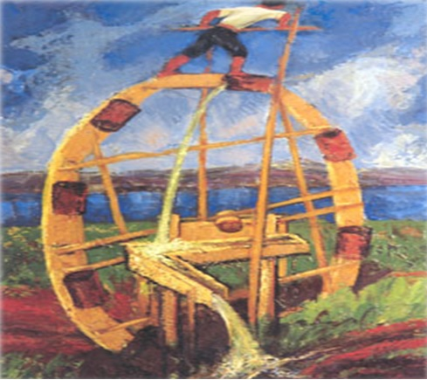

Slide 8
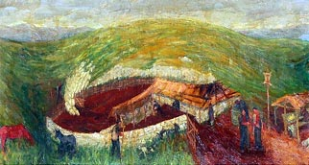

Slide 9
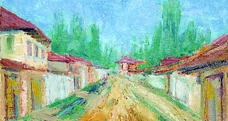

Slide 10
